Slide 1

Emily Schmidt
Turning Service into a Growth Engine
Leveraging AI-driven mobile support to enhance customer experience and reduce churn at scale
Product Management Project

Slide 2

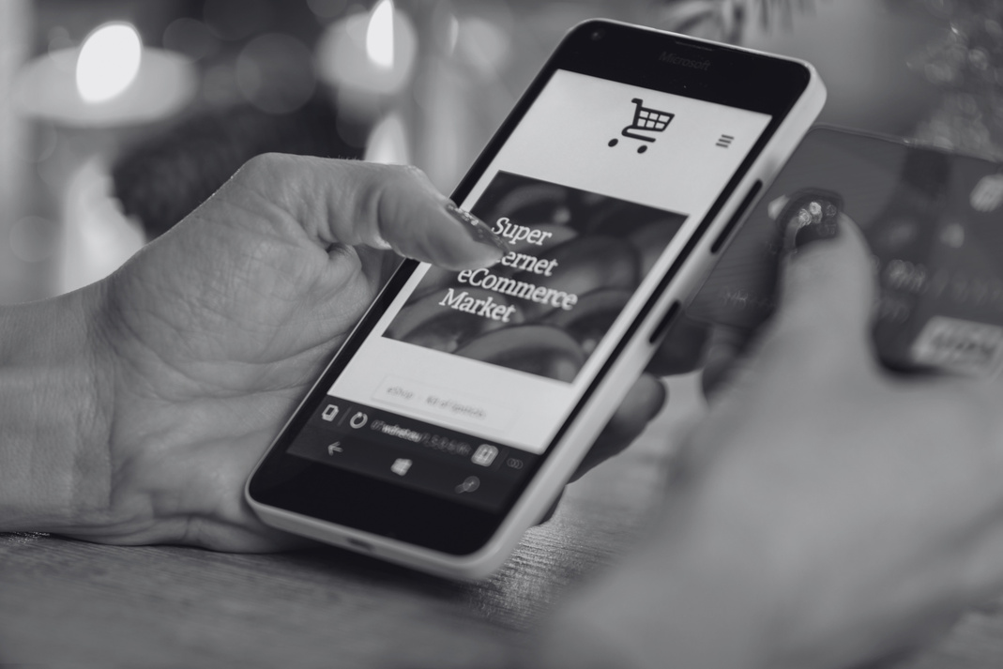


Who We Are
Strategic Pillars
A global digital commerce and subscription platform combining e-commerce, embedded finance, and membership-based services — accessible via web and mobile.
Unlike traditional retailers, the platform offers proprietary credit-based purchasing (pay-over-time or stored credit), enabling higher transaction values and increased customer lifetime value.
Positioned at the intersection of retail, fintech, and subscription ecosystems.
Customer Lifetime Value
Repeat Engagement
Churn Minimization

Slide 3





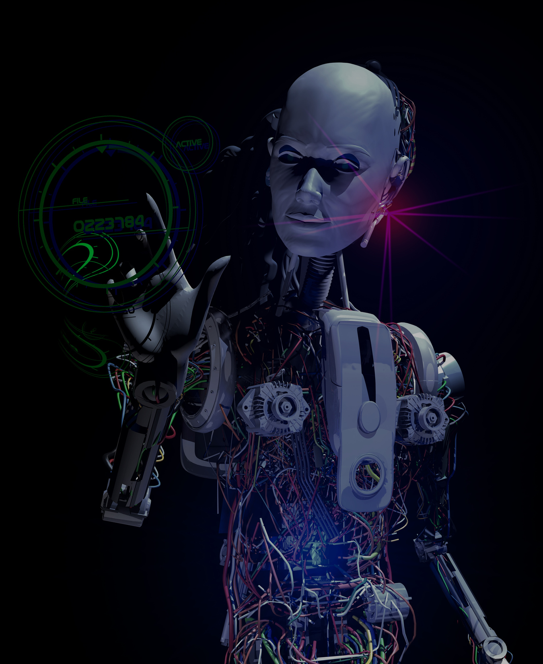
Customer Segments
Target Segment
Engaged Super Consumers
Promo Bulk Buyers
Low-Intent Browsers
Deal-Seeking Loyalists
Dormant High Engagers
Highest CLV & frequency — no discounts needed. Elevated churn signals a critical retention gap.
Bulk purchases during promos. High returns, low loyalty outside discounts.
Browse without converting. Minimal revenue, weak purchase intent.
High repeat volume driven by discounts. Strong activity, lower margins.
Previously active, now lapsed. Reactivation potential, uncertain value.

Slide 4





Target Persona
Persona Identity
Goals & Motivation
: 37 y.o.
: Investment Banker
Purpose
Reasons
: Maintain reputation, get promoted.
: Keeping up with trends on the go
Background
Pain Points (Challenges)
: New York, New York
: Upper-middle class
Challenge
Frustration
: Demanding work& life schedule
: Limited patience for waiting & resolving issues
Samuel
Tech Behaviour
Potential Bias
Online Shoping
Social Media
Values speed and convenience over personalization; may view chatbots as efficient but lacking a human touch.

Slide 5
Customer Journey Map
Awareness
Consideration
Acquisition
Engagement
Purchase
Post-Purchase
Service
Outcome
Discovers the brand through ads or word of mouth.
Browses website and reads reviews.
Creates an account; Opts into communications.
Receive emails, SMS, ads & wish-list alerts designed to bring them back.
Browses, and add items to wish-list or cart; Checks out.
Receives product;
May leave a review or share on socials.
Experiences issues; Attempts to resolve before escalating to email or phone.
Decides to stay or unsubscribe due to personal reasons or poor experience.
Irrelevant positioning, negative shared experiences
App instability, poor UI/CX, negative reviews, irrelevant offerings
Too many irrelevant messages at the wrong time
Hidden fees, failed promos, and unreliable delivery
Damaged or misrepresented product, late or missing delivery
Long waits, unclear resolution path, & cases closed without a fix
Card required at time of subscription
Complicated cancel procedures

Slide 6
The Core Challenge
$2.8M
CLV Lost to Churn
in target segment alone
45%
Target Segment Churn Rate
30%
Overall Churn Rate
vs. 15% industry avg.

Slide 7
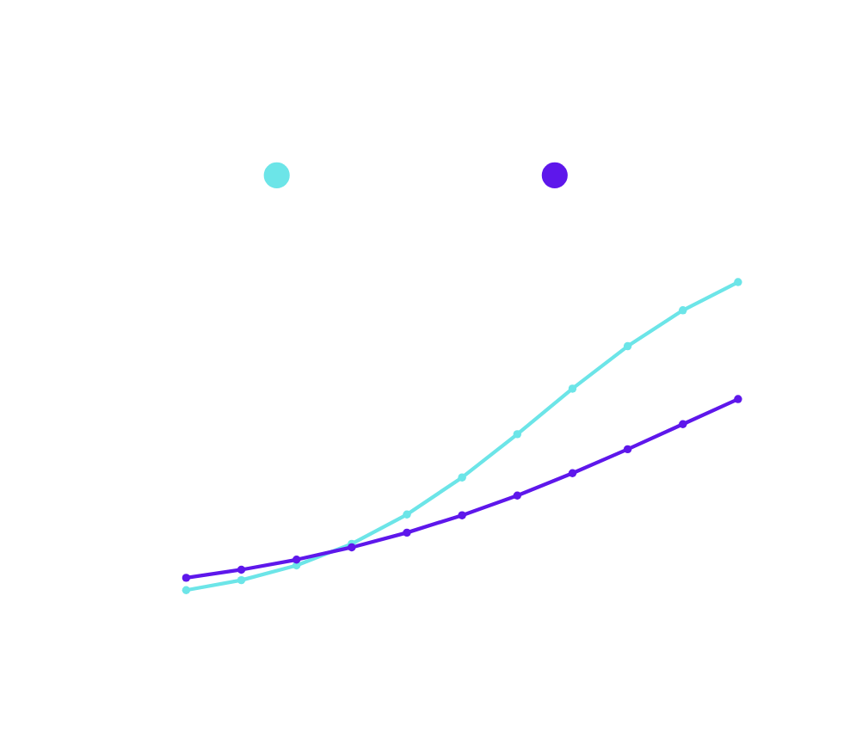
What Drives Churn
Service Calls #1 Driver of Churn
Root cause of service interactions are currently unknown
Without structured data from service interactions, identifying and solving churn at source is impossible.
Mobile chat creates a path to structured data on customer issues while simultaneously reducing service friction — addressing churn at the source.

Slide 8
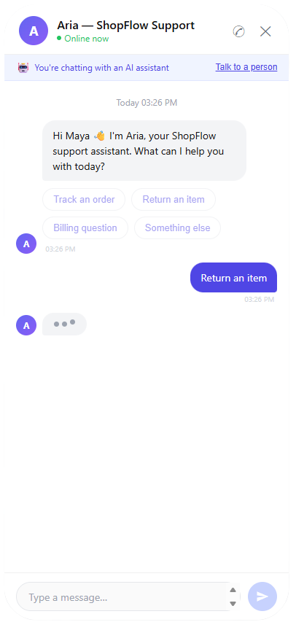
Product Overview
An in-app chat platform that connects customers to AI and live support while transforming service interactions into actionable insights on churn and satisfaction.
Demo Link

Slide 9
Business Case
Solves Problem
Financial Case
Strategic Fit
Replaces high-friction phone calls with frictionless mobile chat — directly targeting the #1 churn driver.
Generates structured insight into churn drivers currently missing from data.
Expected NPV of ~+$1.8M using DCF model.
Includes an abandon option if retention doesn't improve after Year 1.
Reduces churn → increases CLV.
Encourages mobile app engagement.
Leverages the mobile app already beloved by customers.
Leverages the mobile app already beloved by customers.

Slide 10
MVP
What we are building
Goal: Prove customers will use in-app chat and capture churn driver insights
Customer Experience
Structured Data Capture
System Enablement
In-app 'Chat Now' entry point
Real-time chat with live agents
AI-guided chat for fast resolution
Guided intake: issue type, order ID
Auto-logging of interaction metadata
Post-chat CSAT survey (1–5)
Integration with account + order history
Centralized database for all interactions

Slide 11
Future Phases
What we are building
Goal: Automate, predict, and proactively reduce churn
Customer Experience
Structured Data Capture
System Enablement
AI agents to handle common issues
Smart routing + faster escalation
ML models to identify churn drivers
Real-time churn risk dashboard
Triggered interventions before churn
Predictive issue detection
AI-powered insights for leadership

Slide 12
KPIs
6-12 Month Timeline
Measuring Success
Primary KPI
10% reduction in overall churn
Secondary KPIs
30% chat adoption
5 pts increase in CSAT
10% faster first contact resolution
15-20% reduction in avg. resolution time
Operational Impact
15-20% decrease in call center vol.
15-20% decrease in cost per interaction
Guardrails
App crash / error rate below baseline
No increase in complaints or escalations
Support wait times maintained or improved

Slide 13
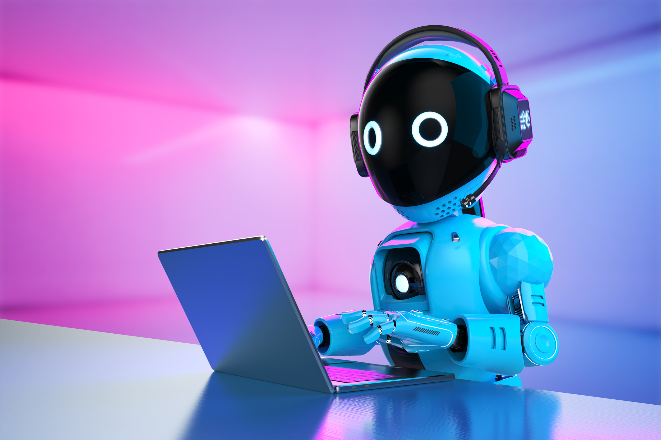
Unlock the Next Era of Customer Experience
The Engaged Super Consumers are the company's most engaged and highest-value customer group. Winning them back — through a better service experience — is both a retention and a revenue growth strategy.
Let’s Make It Real!

